Slide 1
Introduction
DEBASISH SHAOO

Slide 2
Overview Of Java
Java is one of the world's most important and widely used computer languages, and it has held this distinction for many years.

Slide 3
Creation of Java
Java was developed by James Gosling, Patrick Naughton, Mike Sheridan at Sun Microsystems Inc. in 1991. It took 18 months to develop the first working version.
The initial name was Oak but it was renamed to Java in 1995 as OAK was a registered trademark of another Tech company.

Slide 4
Evolution Of Java
Java was initially launched as Java 1.0 but soon after its initial release, Java 1.1 was launched. Java 1.1 redefined event handling, new library elements were added.
In Java 1.2 Swing and Collection framework was added and suspend(), resume() and stop()methods were deprecated from Thread class

Slide 5
Application of Java
Java is widely used in every corner of world and of human life. Java is not only used in softwares but is also widely used in designing hardware controlling software components. There are more than 930 million JRE downloads each year and 3 billion mobile phones run java.

Slide 6
Conti…
Following are some other usage of Java :
Developing Desktop Applications
Web Applications like Linkedin.com, Snapdeal.com etc
Mobile Operating System like Android
Embedded Systems
Robotics and games etc.

Slide 7
Features Of Java

Slide 8
Simple
Java is easy to learn and its syntax is quite simple, clean and easy to understand. The confusing and ambiguous concepts of C++ are either left out in Java or they have been re-implemented in a cleaner way.
Eg : Pointers and Operator Overloading are not there in java but were an important part of C++.

Slide 9
Object Oriented
In java everything is Object which has some data and behaviour. Java can be easily extended as it is based on Object Model.

Slide 10
Robust
Java makes an effort to eliminate error prone codes by emphasizing mainly on compile time error checking and runtime checking. But the main areas which Java improved were Memory Management and mishandled Exceptions by introducing automatic Garbage Collector and Exception Handling

Slide 11
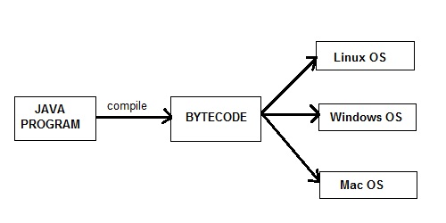
Platform Independent
Unlike other programming languages such as C, C++ etc. which are compiled into platform specific machines. Java is guaranteed to be write-once, run-anywhere language.

Slide 12
Secure
When it comes to security, Java is always the first choice. With java secure features it enable us to develop virus free, temper free system. Java program always runs in Java runtime environment with almost null interaction with system OS, hence it is more secure.

Slide 13
Multi Threading
Java multithreading feature makes it possible to write program that can do many tasks simultaneously. Benefit of multithreading is that it utilizes same memory and other resources to execute multiple threads at the same time, like While typing, grammatical errors are checked along.

Slide 14
Architectural Neutral
Compiler generates bytecodes, which have nothing to do with a particular computer architecture, hence a Java program is easy to intrepret on any machine.

Slide 15
Portable
Java Byte code can be carried to any platform. No implementation dependent features. Everything related to storage is predefined, example: size of primitive data types

Slide 16
High Performance
Java is an interpreted language, so it will never be as fast as a compiled language like C or C++. But, Java enables high performance with the use of just-in-time compiler.

Slide 17
Introduction to JVM

Slide 18
What is JVM?
Java virtual Machine(JVM) is a virtual Machine that provides runtime environment to execute java byte code. The JVM doesn't understand Java typo, that's why you compile your *.java files to obtain *.class files that contain the bytecodes understandable by the JVM.
JVM control execution of every Java program. It enables features such as automated exception handling, Garbage-collected heap.

Slide 19
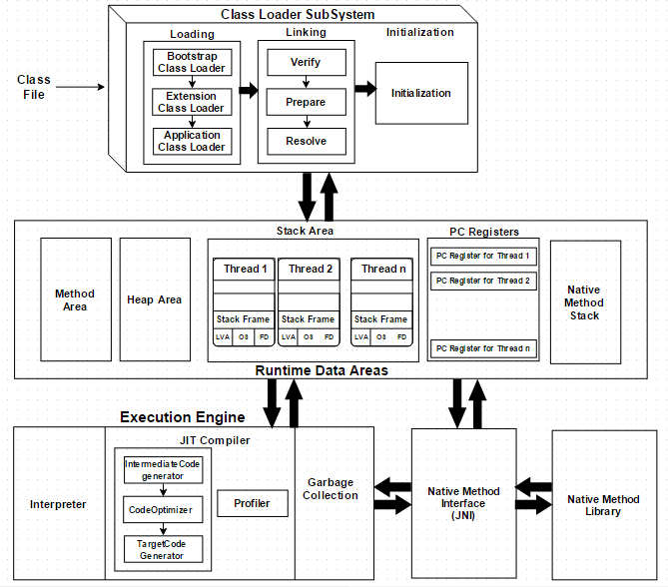
JVM Architecture
JVM = Class loader system + runtime data area + Execution Engine.

Slide 20
Conti..
Class Loader : Class loader loads the Class for execution.
Method area : Stores pre-class structure as constant pool.
Heap : Heap is in which objects are allocated.
Stack : Local variables and partial results are store here. Each thread has a private JVM stack created when the thread is created.
Program register : Program register holds the address of JVM instruction currently being executed.

Slide 21
Conti..
Native method stack : It contains all native used in application.
Executive Engine : Execution engine controls the execute of instructions contained in the methods of the classes.
Native Method Interface : Native method interface gives an interface between java code and native code during execution.
Native Method Libraries : Native Libraries consist of files required for the execution of native code.

Slide 22
Difference between JDK and JRE

Slide 23
JRE : The Java Runtime Environment (JRE) provides the libraries, the Java Virtual Machine, and other components to run applets and applications written in the Java programming language.
JRE does not contain tools and utilities such as compilers or debuggers for developing applets and applications.

Slide 24
Conti..
Java Database Connectivity (JDBC) API: Provides tools for developers to write applications with access to remote relationship databases, flat files, and spreadsheets.
Logging: Produces log reports—such as security failures, configuration errors, and performance issues—for further analysis.
Java Archive (JAR): A platform-independent file format that enables multiple files to be bundled in JAR format, significantly improving download speed and reducing file size.

Slide 25
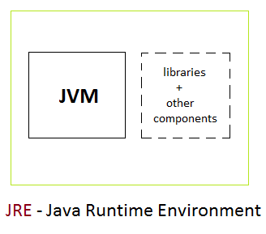
JRE
JRE = JVM + Java Packages Classes(like util, math, lang.. )+runtime libraries.

Slide 26
JDK : The JDK also called Java Development Kit is a superset of the JRE, and contains everything that is in the JRE, plus tools such as the compilers and debuggers necessary for developing applets and applications.

Slide 27
Conti..
JDK is an acronym for Java Development Kit, a software package employed for creating a java based apps and applets.
It is an overall package that is used to both develop and run a program in java.
In addition with JVM and JRE it also contains Java source compilers, Java debuggers, bundling and deployment tools.
The distinction is that the JDK is a package of tools for developing Java-based software, whereas the JRE is a package of tools for running Java code.

Slide 28
Conti..
Java :The loader for Java applications. This tool is an interpreter and can interpret the class files generated by the javac compiler. Now a single launcher is used for both development and deployment. The old deployment launcher, JRE, no longer comes with Sun JDK, and instead it has been replaced by this new java loader.
Javac : It specifies the Java compiler, which converts source code into Java bytecode.

Slide 29
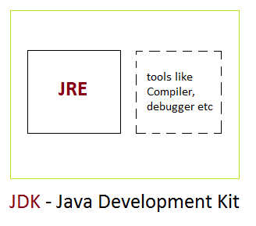
JDK
JDK = JRE + Development/debugging tools

Slide 30
Just-In-Time(JIT) compiler: It is used to improve the performance. JIT compiles parts of the byte code that have similar functionality at the same time, and hence reduces the amount of time needed for compilation. Here, the term "compiler" refers to a translator from the instruction set of a Java virtual machine (JVM) to the instruction set of a specific CPU
JIT in Java is an integral part of the JVM.

Slide 31
Conti..
JIT compilation Two approaches
AOT (Ahead-of-Time compilation)
AOT compiler compiles the code into a native machine language (the same as the normal compiler).
It transforms the bytecode of a VM into the machine code.
Interpretation to translate code into machine code.

Slide 32
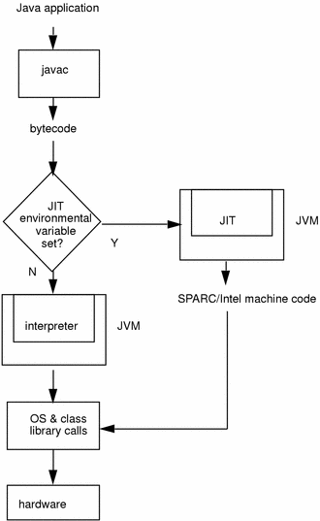
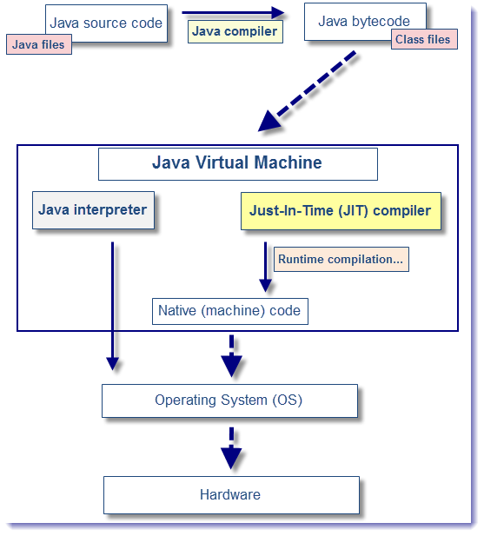
JIT

Slide 33
